Slide 1
^{Crime and}
^{Punishment} in Kent and Medway post-visit presentation

Slide 2
Dividing Line
If you are poor, you’re more likely to commit a crime
You should always tell the truth
The more rules there are, the more rule breakers there are
We need people in charge
Punishments should be the same for everyone
Laws don’t change
You get what you deserve
People can be impartial/objective
Notes:
Using open space, split the space in half with agree on one side, disagree on the other and a line down the middle for the undecided. Make statements relating to crime and punishment and ask children to stand to indicate if they agree/disagree and discuss.

Slide 3
Police Uniform
How has it evolved?
Admiralty
Constabulary
1949
Watchman
1686
Dockyard
Police
1834
Royal Marine Police
1934
Civilian Guard
1574
Marine
Military Guard
1792
Metropolitan
Police
1863
Notes:
Why have the police changed uniforms and kits over the years? What have they kept?

Slide 4
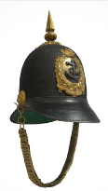



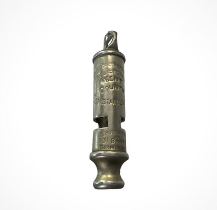
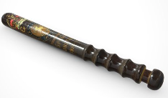
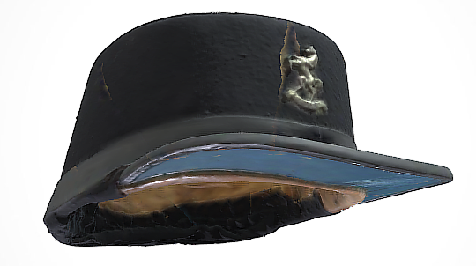
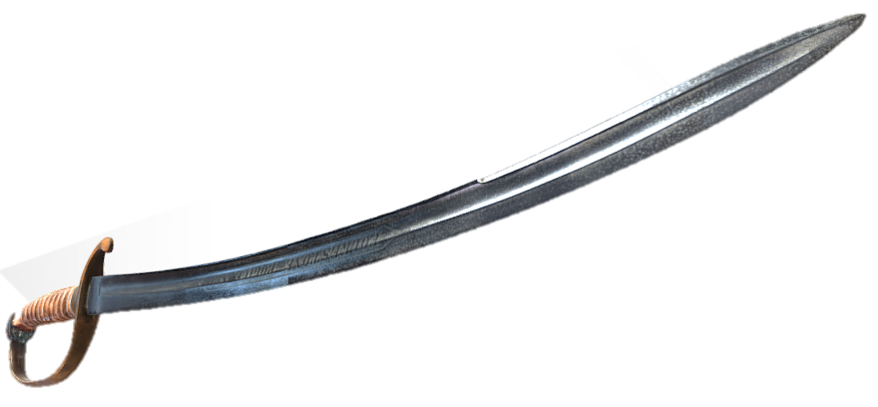
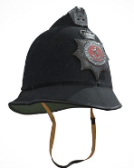
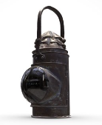
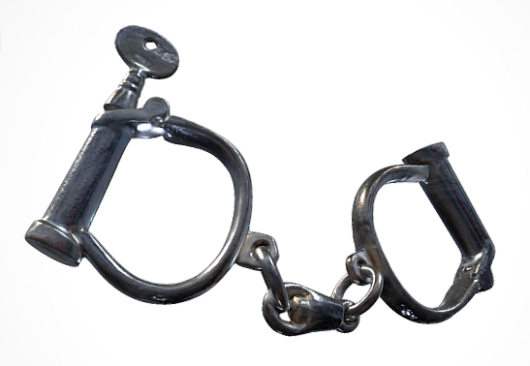
Kit from the past
Kent Police Museum
View the collection in 3D
Guildhall Museum
View the collection in 3D
Notes:
Look in more detail at older police kit. How were they used? Would they be useful now? What do contemporary police use instead?

Slide 5
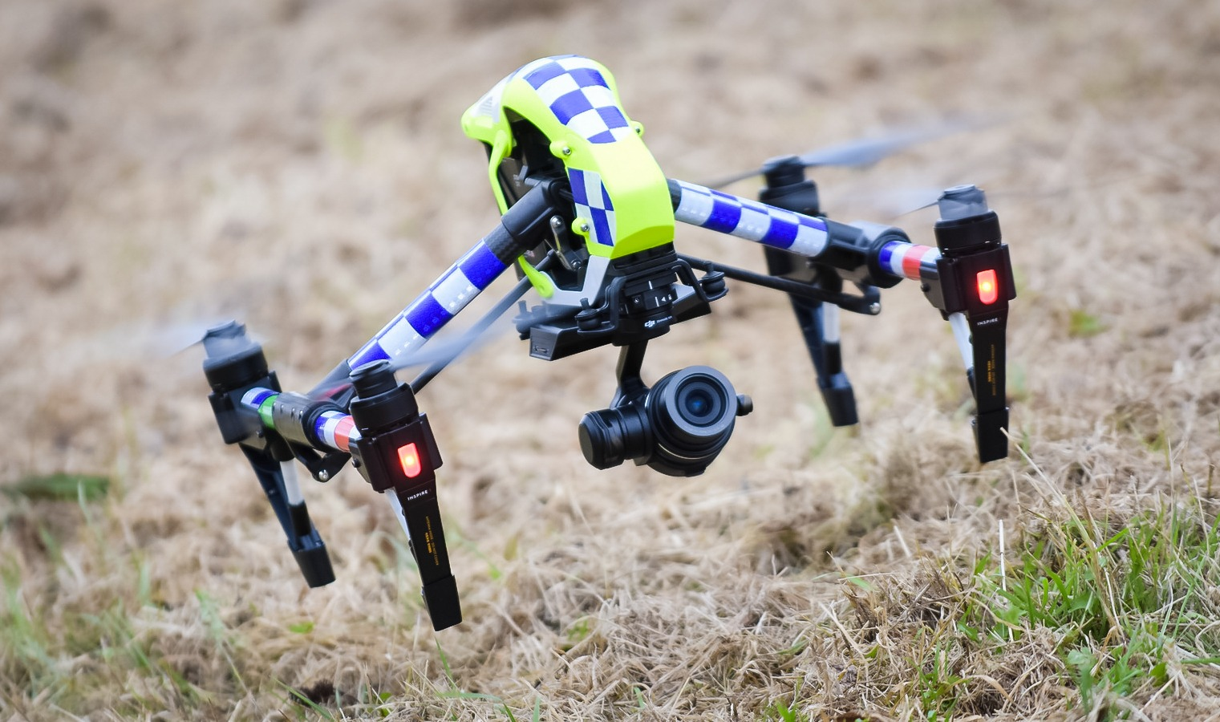
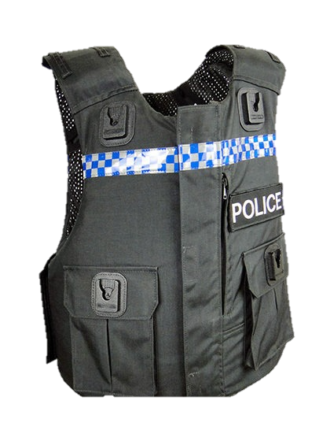


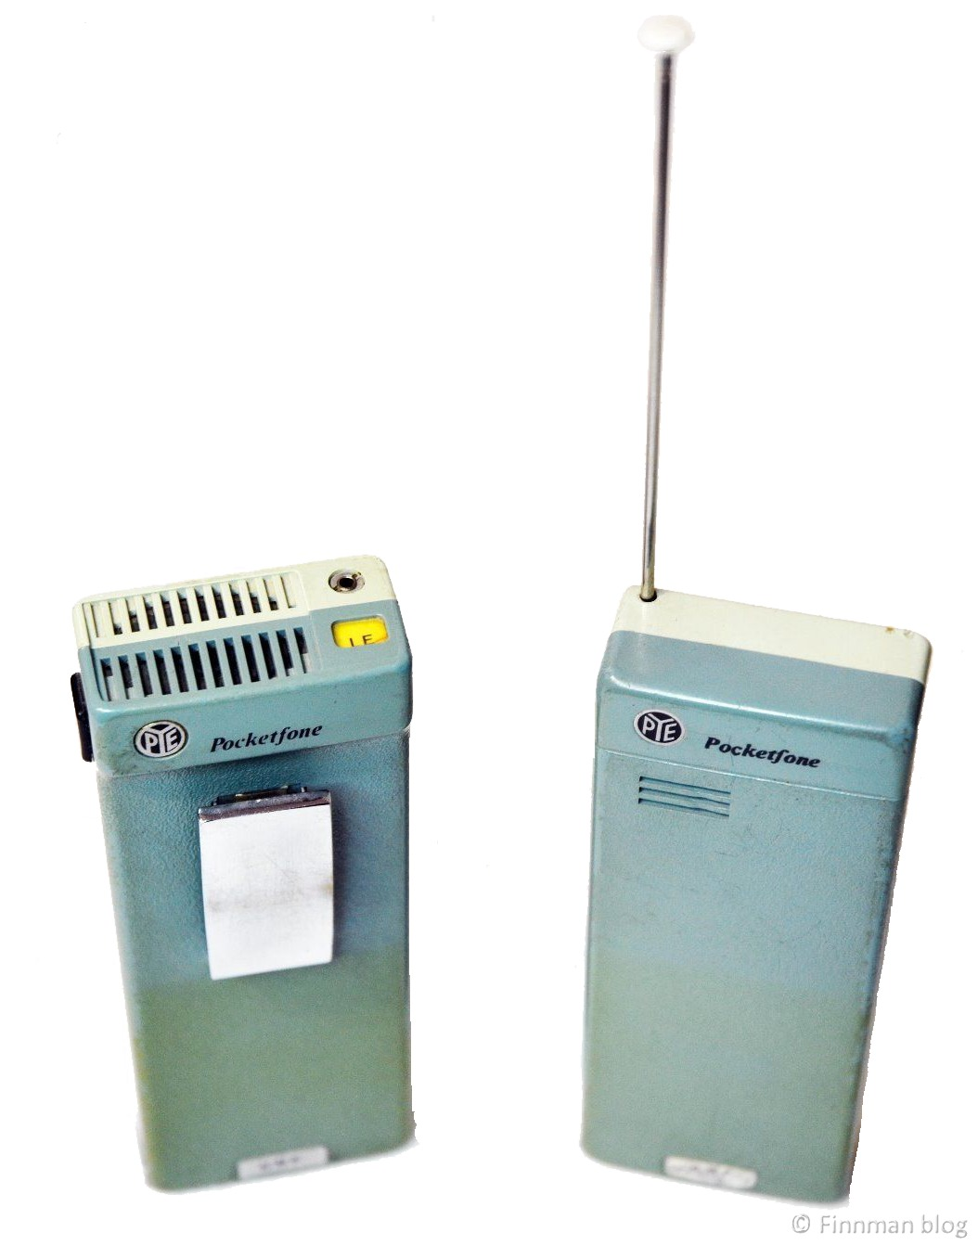
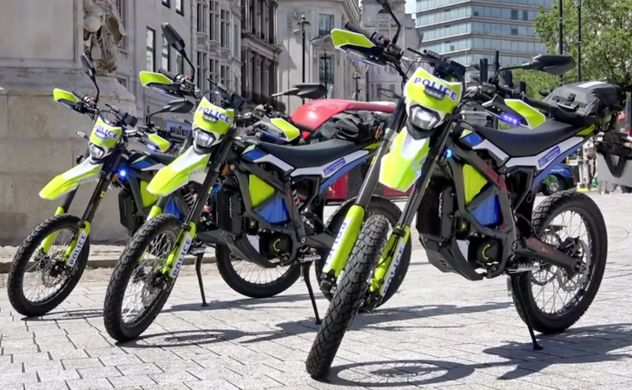
Upgrading police kit
Notes:
Some examples of things the police have used. Are any of these still in use? Why? The world is always changing, new technologies and ways of living. Design and create your own future kent force? Think of adding protection gear, detection tools, transport and digital resources.

Slide 6
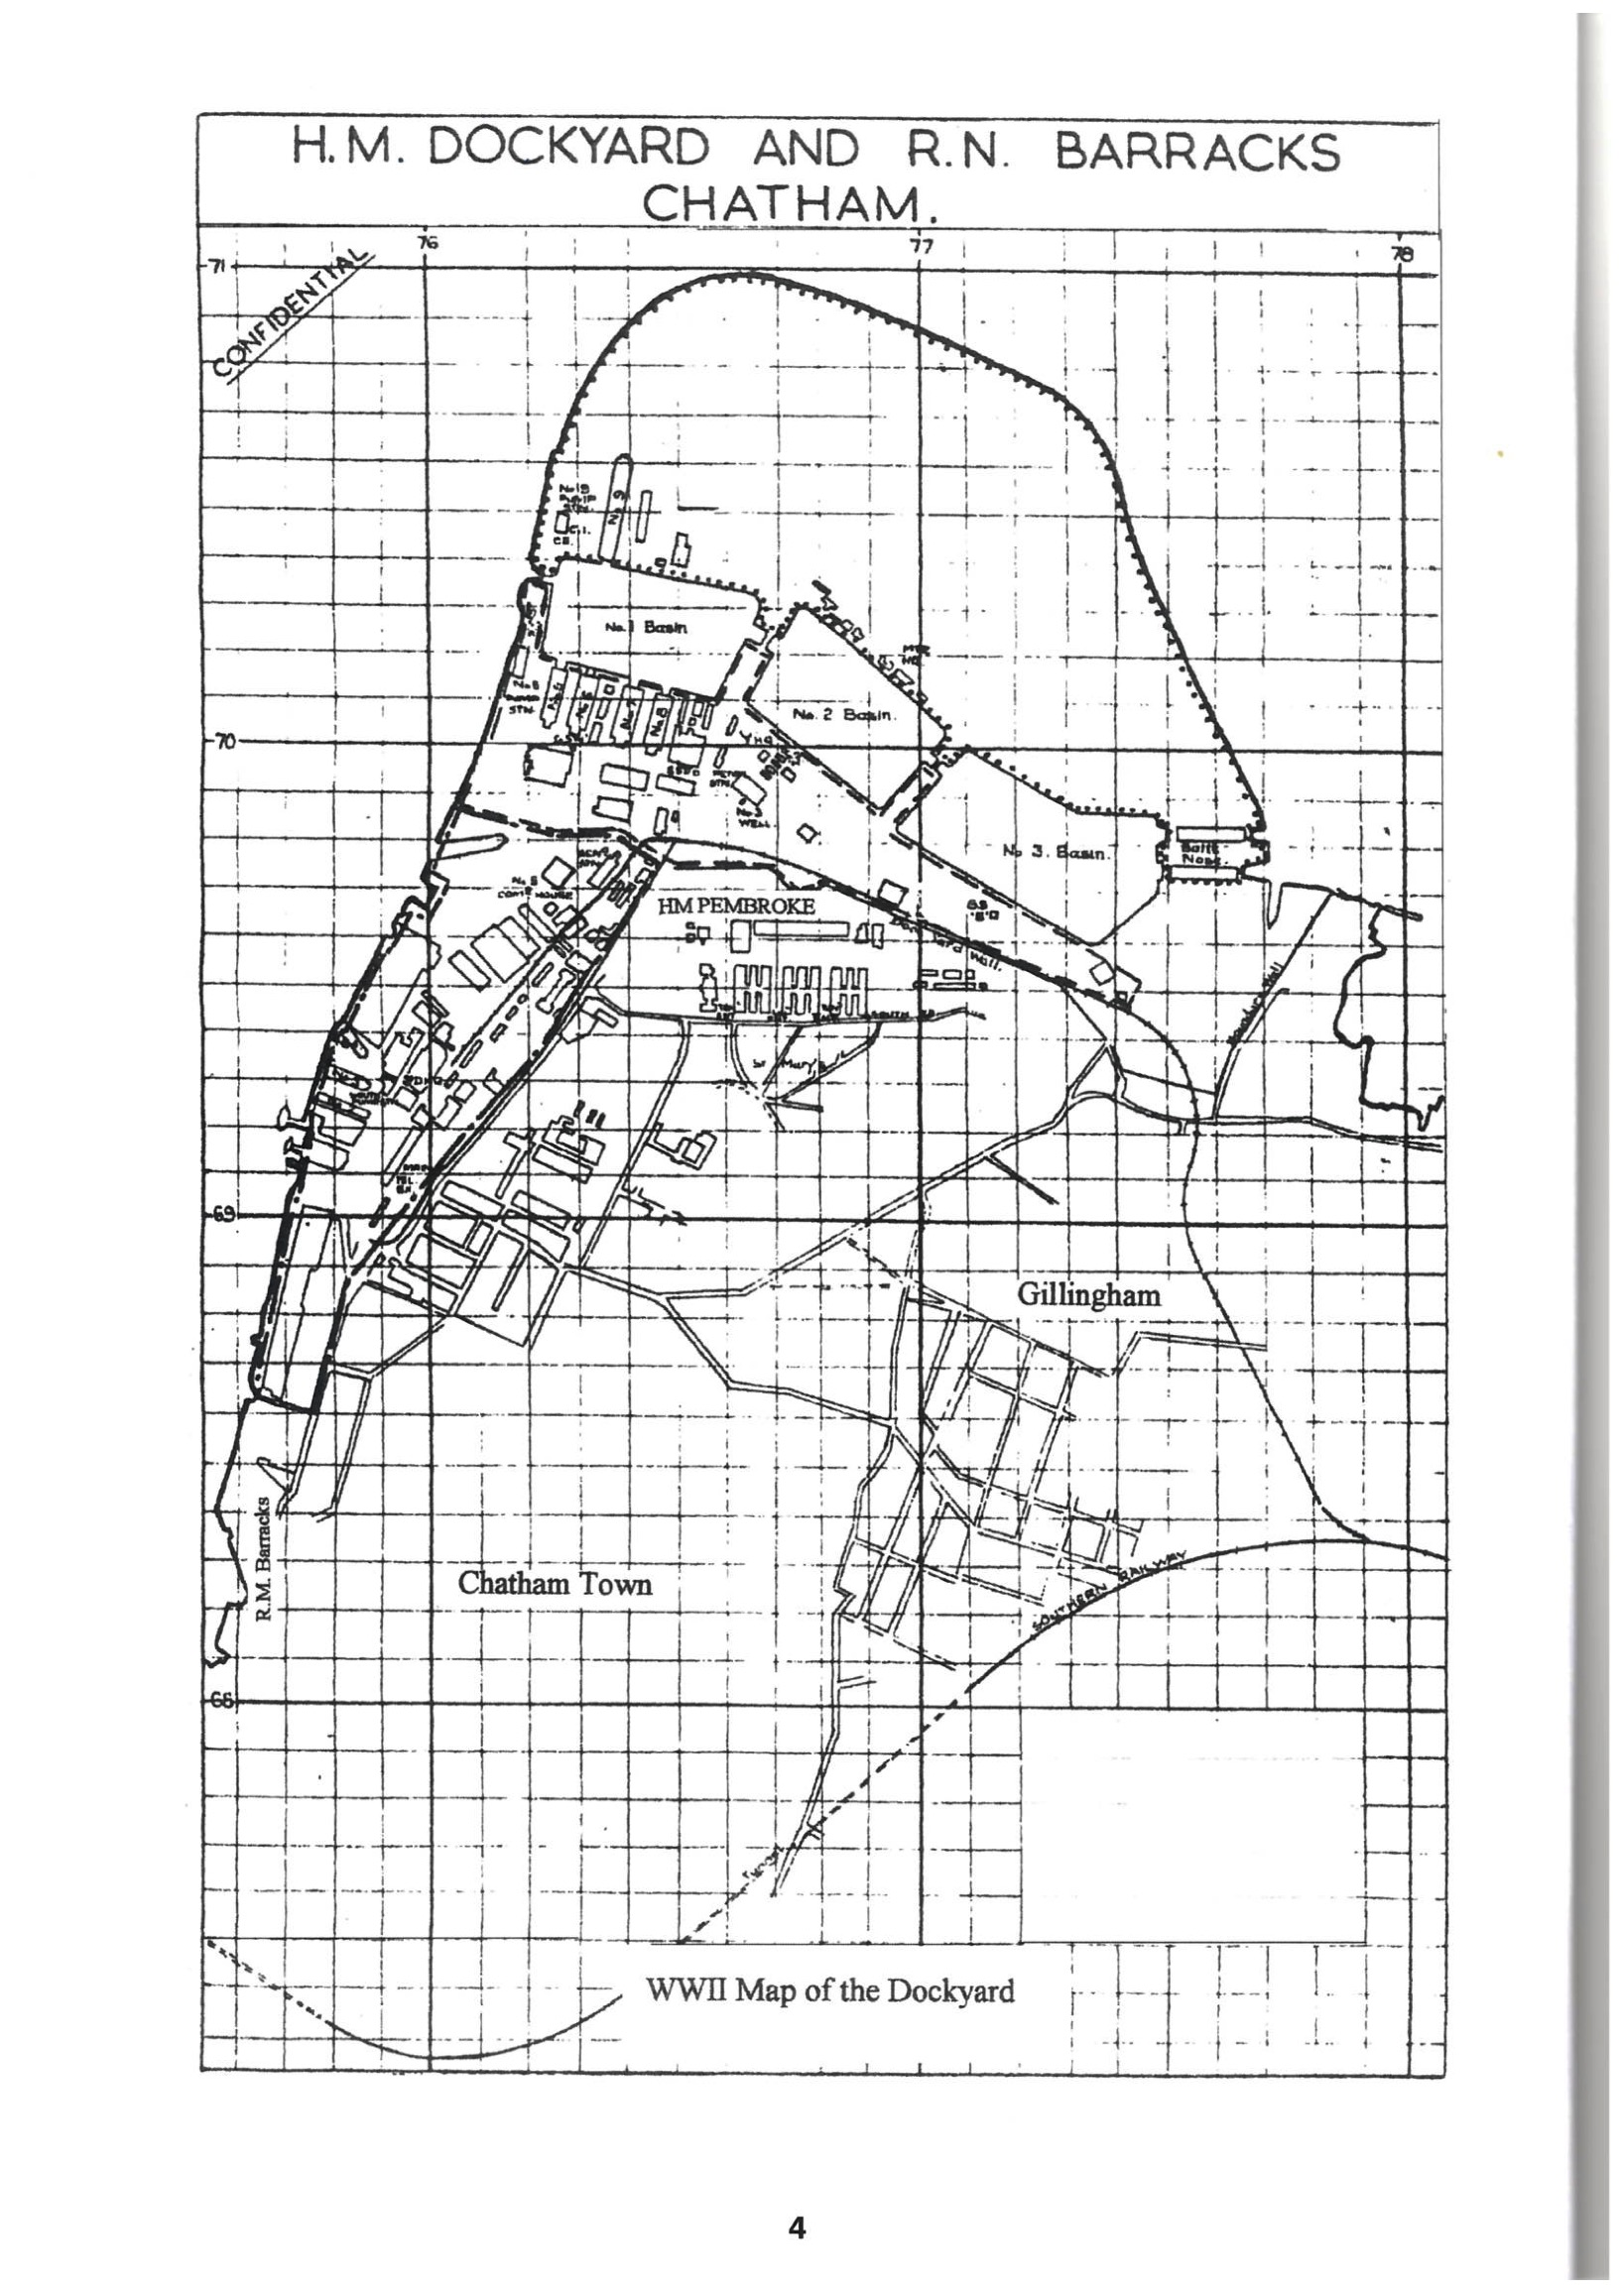
Protect the Dockyard
What crimes do you need to protect against?
What resources do you need?
How will you use them?
Notes:
After thinking about the above questions as a class, split into groups for each time period. Groups decide what security measures you could put in place (protectors) using what was available in the time period they were assigned.

