Slide 1
^{Crime and}
^{Punishment}
^{in Kent} ^{and Medway}
^{pre-visit presentation}

Slide 2
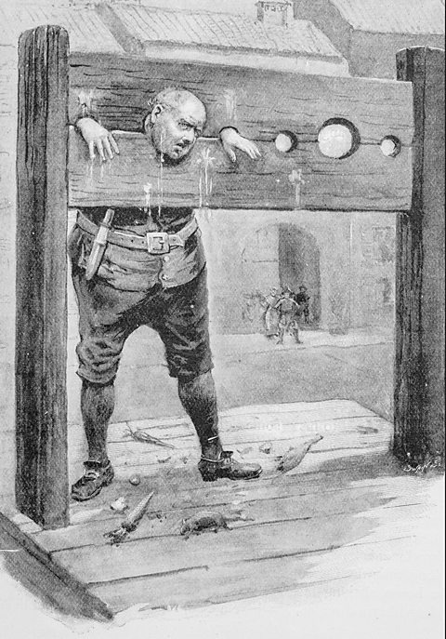
^{Pre} ^{Industrial Age}
^{Before 1760}

Slide 3
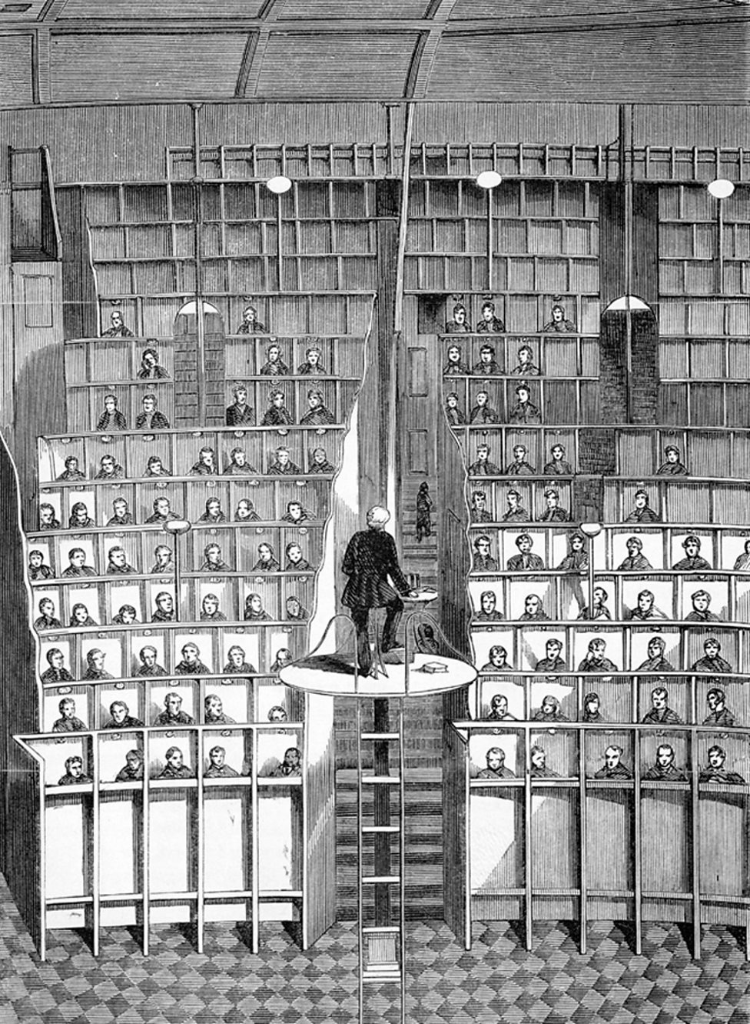
^{Industrial Age}
¹⁷⁶⁰ ⁻ ¹⁹⁰⁰

Slide 4
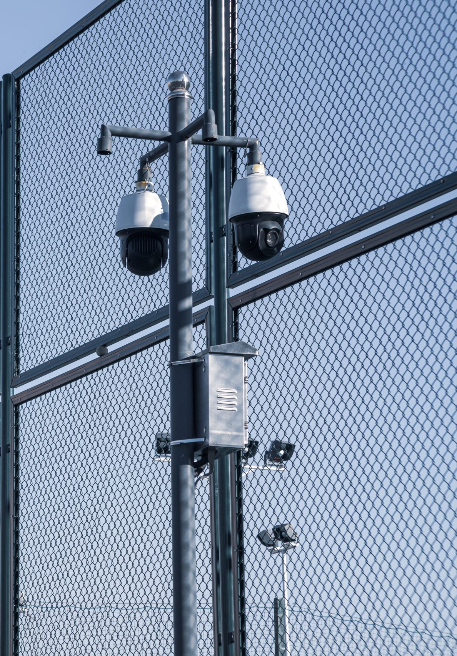
^{Modern Age}
^{1900 - Present}

Slide 5
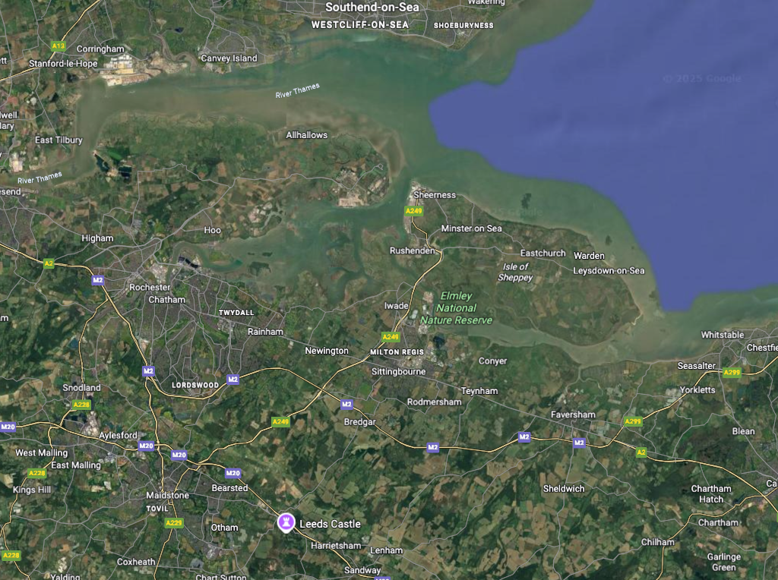
^{Kent}
²⁰²⁵
Notes:
Introduce Modern/Contemporary map: where/when is this map from? locate and plot current places
look for locations: home, school, local landmarks, kent police museum Faversham, Chatham dockyard, Guildhall museum Rochester

Slide 6
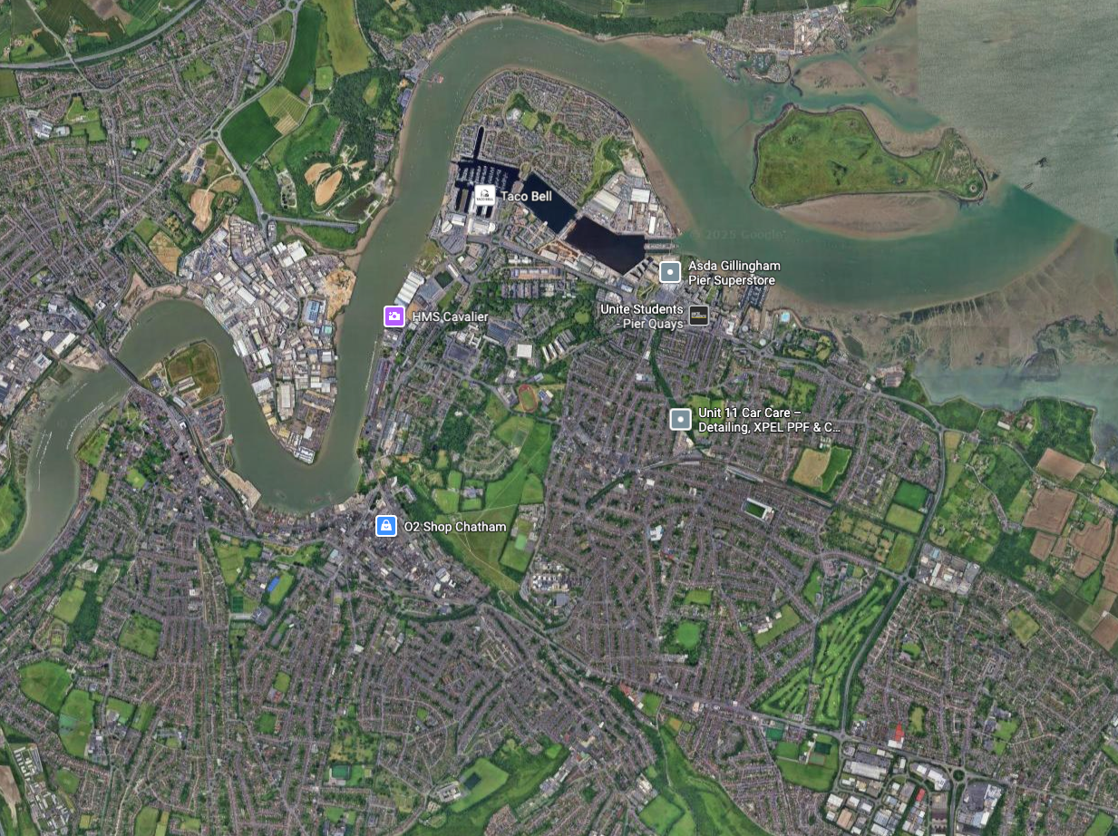
^{Medway}
²⁰²⁵

Slide 7
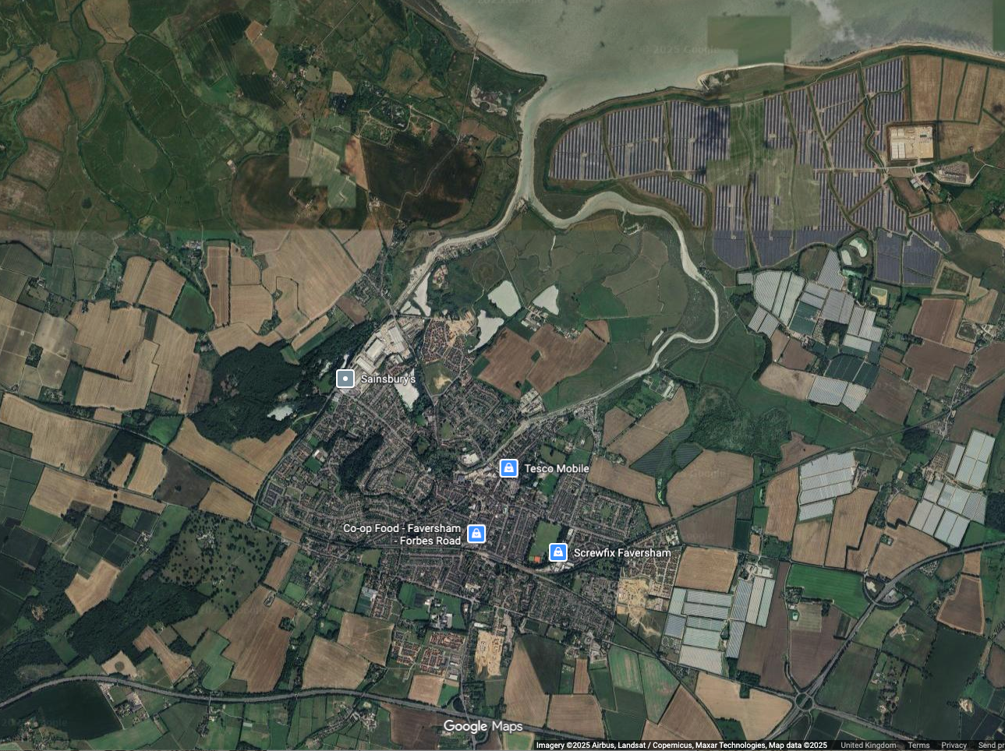
^{Medway}
²⁰²⁵

Slide 8
^{Kent}
¹⁸⁰¹
Notes:
Going back in time. Where/when is this map from? Note any changes about how it is made.
look for : familiar places, sites relevant to the theme and social change indicators

Slide 9
^{Medway}
¹⁸⁰¹

Slide 10
^{Faversham}
¹⁸⁰¹

Slide 11
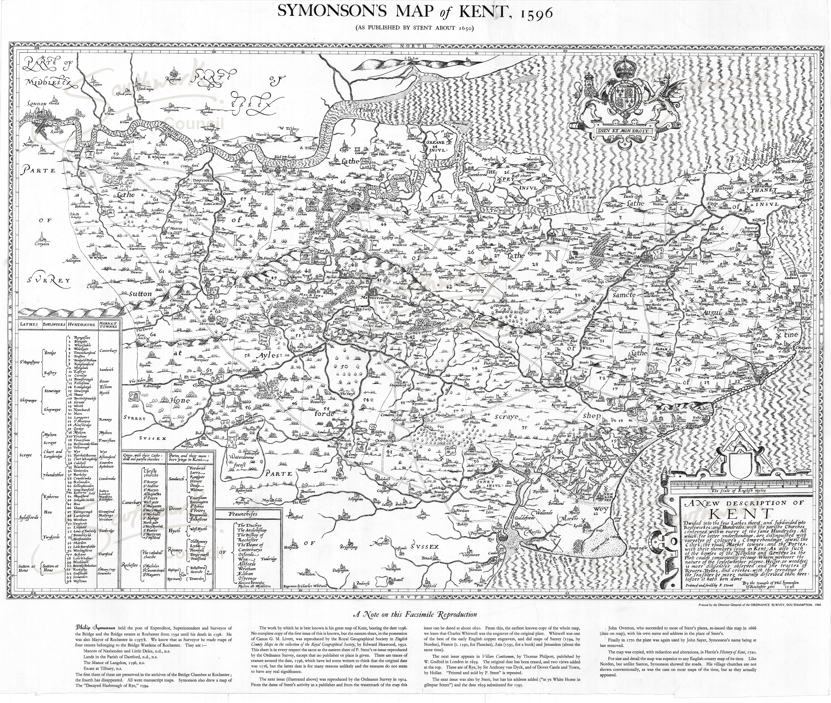
^{Kent}
¹⁵⁹⁶
Notes:
Medieval/Tudor/Stuart map: where/when is this map from? note any changes about how it is made to the previous two.
look for : familiar places, sites relevant to the theme and social change indicators

Slide 12
^{Medway}
¹⁵⁹⁶

Slide 13
^{Faversham 1596}

Slide 14
Civilian Guard
1574
Watchman
1686
Marine
Military Guard
1792
Dockyard
Police
1834
Metropolitan
Police
1863
Royal Marine Police
1934
Admiralty
Constabulary
1949
Notes:
Put in timeline order

Slide 15
Timeline
Dockyard Policing
Admiralty
Constabulary
1949
Watchman
1686
Dockyard
Police
1834
Royal Marine Police
1934
Civilian Guard
1574
Marine
Military Guard
1792
Metropolitan
Police
1863
Notes:
In correct timeline order, There have been organized policing at the dockyard since Samuel Pepys, then Secretary to the Admiralty, appointed Watchmen (Porters) assisted by Rounders – to patrol and Warders- to look after prisoners in 1686

Slide 16
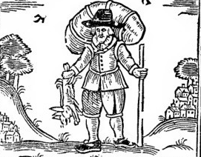
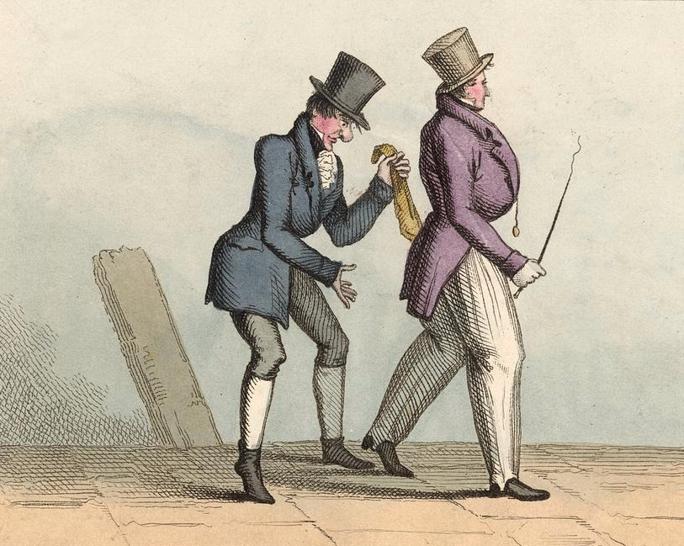

Timeline
Do the crime
Vagrancy
Pick pocket
Car Theft
Notes:
Compare these punishments. Think about: Why the crimes are different in each each time period? Do some crimes continue throughout? Are some bigger crimes than others?

Slide 17
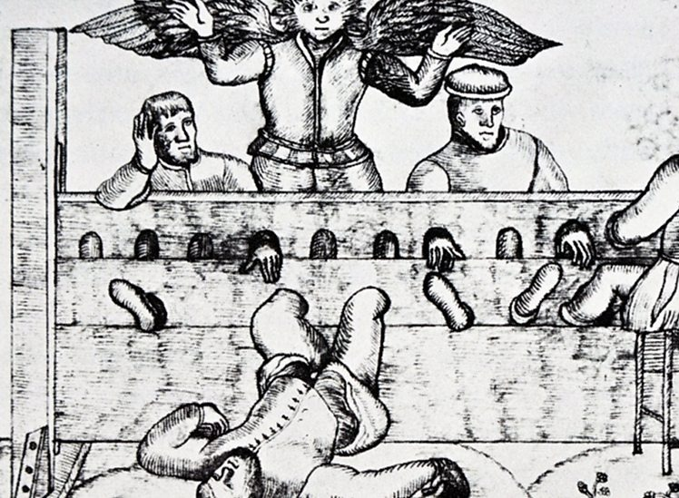
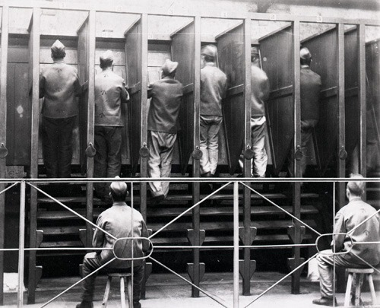
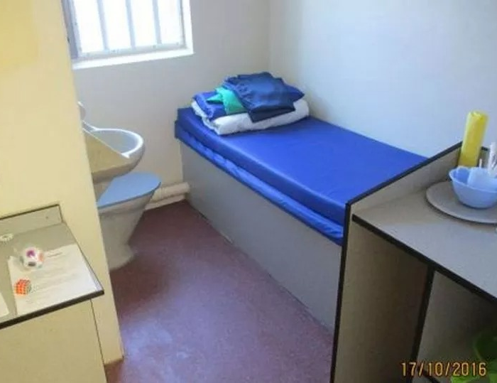
Timeline
Do the time
Stocks
Treadmill
at Pentonville Prison
Young Offenders Cell
Notes:
Compare these punishments. Think about: Why do the punishments change? What would be the most boring punishment? Which would be the most exhausting? Why do you think they might prevent people from reoffending? Why do you think we don’t use certain punishments anymore?

Slide 18
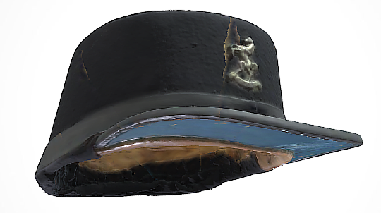
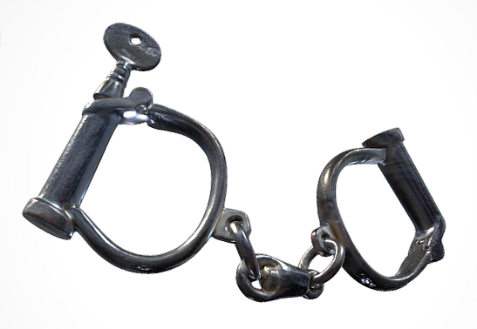
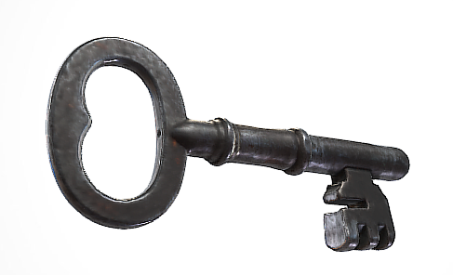
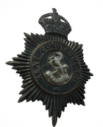
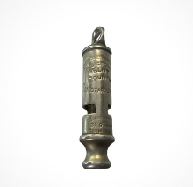
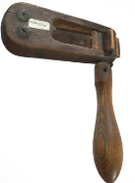
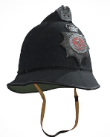
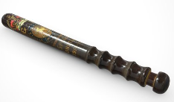
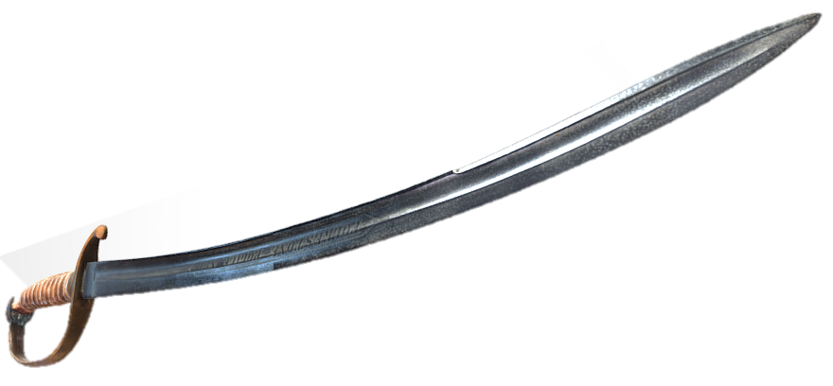
Kent Police Museum
View the collection in 3D

Slide 19
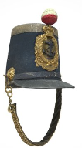
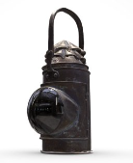

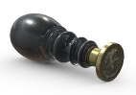
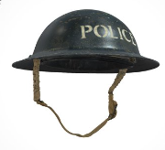
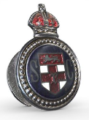
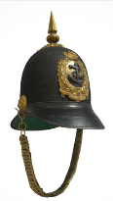
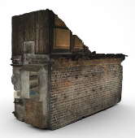
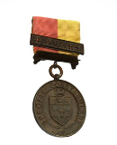
Guildhall Museum
View the collection in 3D

